Slide 1


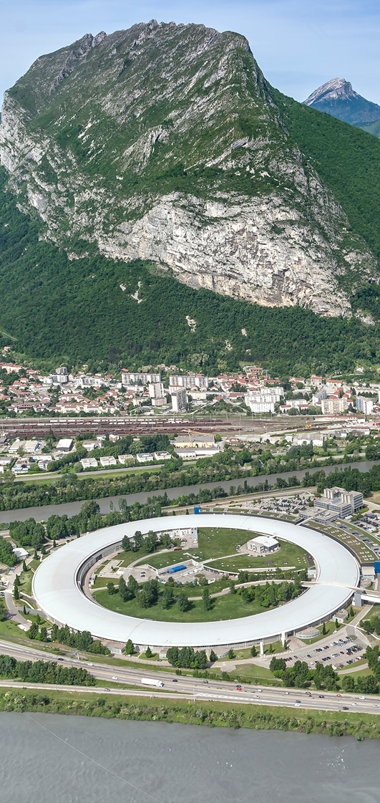
SHADOW4: the popular ray tracing revived for evolving synchrotron sources in 4th-generation storage rings
Manuel Sánchez del Río*¹, Juan Reyes-Herrera¹, Xianbo Shi² and Luca Rebuffi²
*srio@esrf.eu
¹Advanced Analysis & Precision Unit, MEG/ISDD, ESRF
²APS-Argonne National Lab
Mikrosymposium MS 1/1: Beamline Optics and Diagnostics: 13:00 Tuesday 27 August, 2024

Slide 2
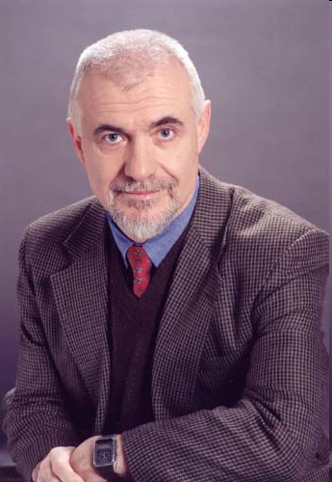
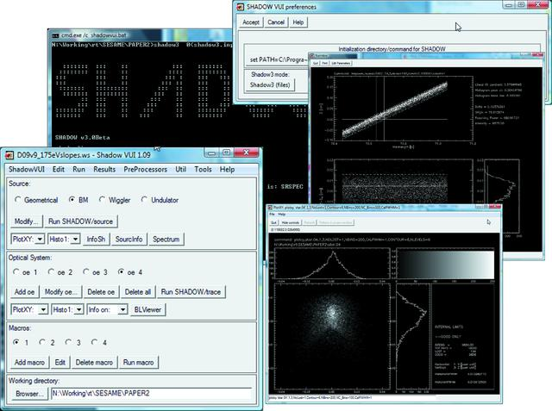
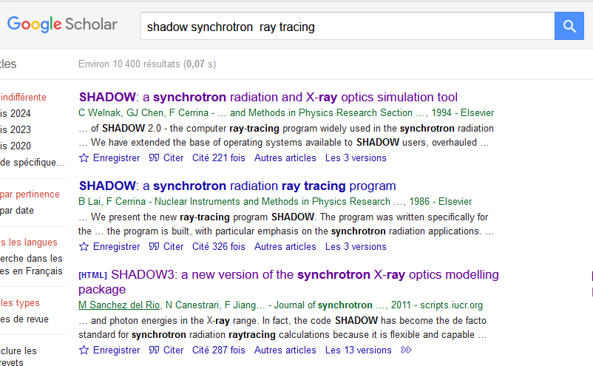
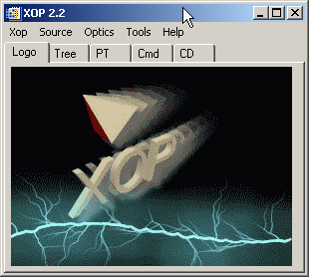
40 YEARS OF Shadow
SHADOW
SHADOW 1 & 2
SHADOW3
Generic ray tracing package for optics
Specialized in SR (storage ring sources, grazing optics, crystals…)
Helped to most 2-4th generations of SR facilities
Used/cited in a huge number of papers
M. Sanchez del Rio, et al.J. Synchr. Rad.18, (2011) http://dx.doi.org/10.1107/S0909049511026306
Kernel (Fortran9x)
Python API
Franco Cerrina (♰2010)
XOP/ShadowVUI
SHADOW1 1984-1990 VAX-VMS mainframes
SHADOW2 1990-2010 Unix workstations+Windows

Slide 3
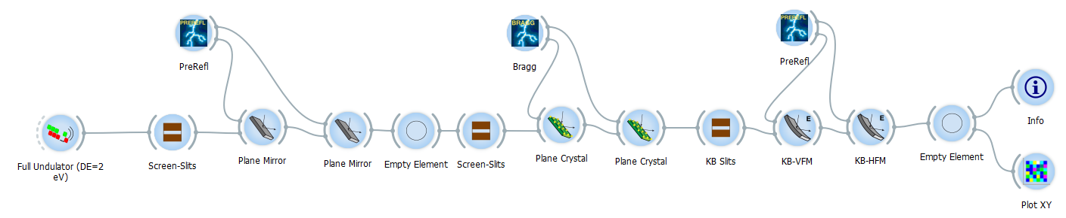
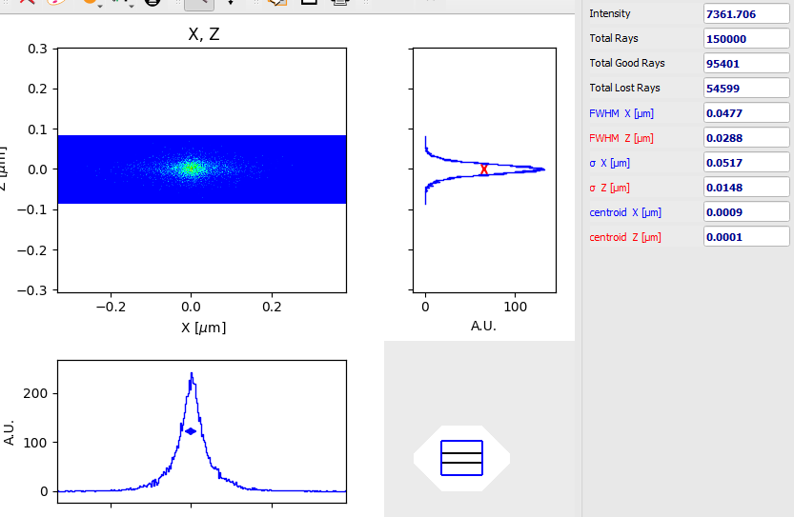
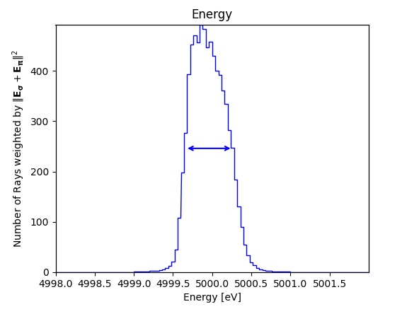
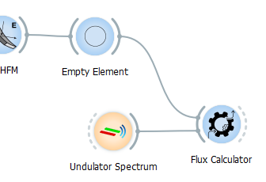
2014: ShadowOUI¹= SHADOW3 + ORANGE²
SIZE RESOLUTION FLUX
0.6 eV
---> Integrated Flux : 1.25321e+13 ph/s
[1] L Rebuffi and M Sanchez del Rio J Synchr. Rad. 23 1357-1367 (2016) https://doi.org/10.1107/S1600577516013837
[2] https://orangedatamining.com/

Slide 4
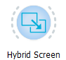
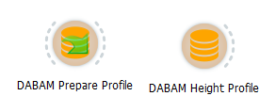
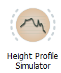

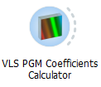
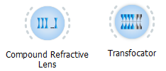
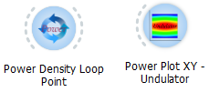
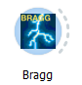
ShadowOUI: not only SHADOW3
Corrections for coherent optics (HYBRID¹)
Surface error databases DABAM, DABAM2D (see poster R. Celestre 1.181)
Preprocessors (surfaces, reflectivity, VLS, diaboloids²)
Elements: CRL, TF, Benders, etc.
Loops & Heat load loops³
New crystal structures (high d-spacing⁴)
[1] Shi et al. 2014 https://doi.org/10.1107/S160057751400650X
[2] Sanchez del Rio et al. 2021 https://doi.org/10.1107/S160057752100401X
[3] Rebuffi et al. 2020 https://doi.org/10.1107/S160057752000778X
[4] Yu et al. 2022 https://doi.org/10.1107/S160057752200707X

Slide 5
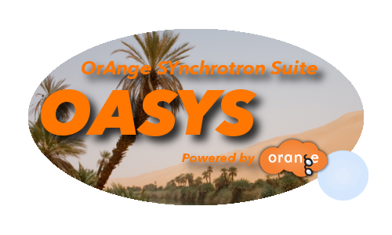
OASYS add-ons
OASYS Main
Tools
SYNED
XOPPY
XRayServer, …
SHADOWOUI
Ray tracing
INTEROPERABILITY
SHADOW4
1.3
SRW
Wave optics
https://oasys-kit.github.io
WOFRY
WISER
Facility Add-Ons, e.g. ESRF
Extensions
Notes:
Before starting, I would like to do the following statement, all calculations presented here were performed using OASYS tools

Slide 6
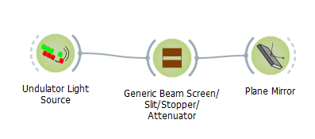
SHADOW4
SHADOW3 problems:
Fortran: compilation: obsolete technology, poorly structured code
Python API maintenance and extension
Python packaging (wheels)
SHADOW4 is a new Kernel, and a new interface, for new generations of sources
Fully developed in Python
OO programming
OASYS experience and ad-hoc developments
Fast enough
SHADOW is an interactive tool adapted for common laptops
Just called SHADOW4
Simplified interface (less widgets, generic mirrors, crystals, etc.)
Optimized (better communication)
Automatic scripting
Preparing 5th generation
Facilitate interoperability with other tools (e.g. for partial coherence)
Adapted for AI integration and Digital Twins (see L Rebuffi’s talk 3/3 Fri 14:00)
Easy transition from laptop prototyping to High-Performance Computing (HPC) and Cloud Computing
Open Source and Collaborative Development
Educational material for interactive leaning

Slide 7
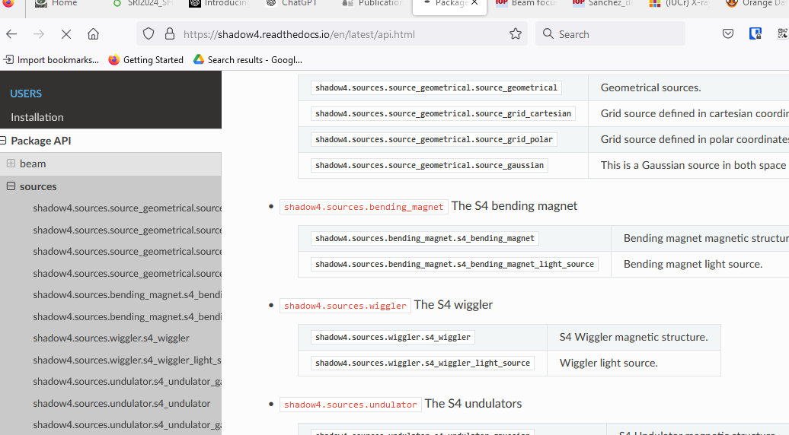
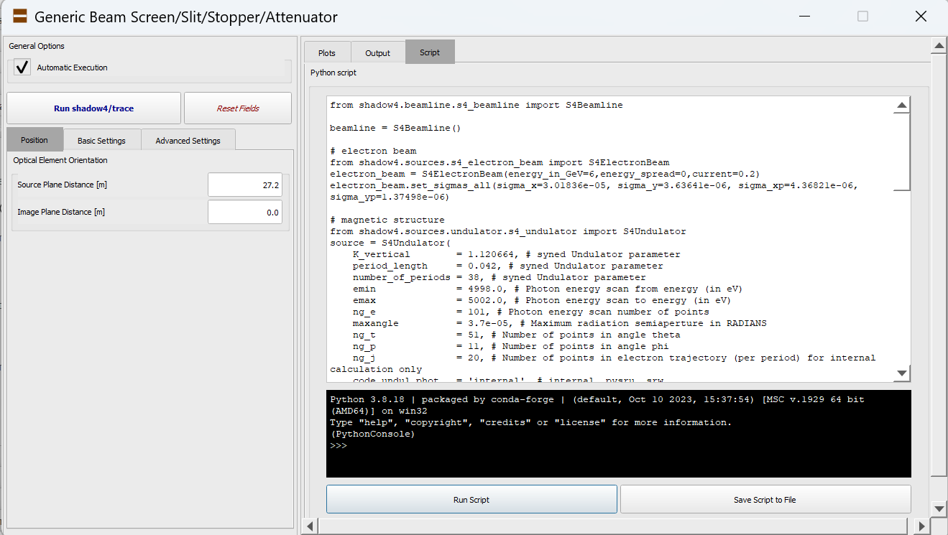
Shadow4 Kernel: Application User Interface
S4Beam: traditional beam data (nrays, 18)
API
S4Beamline
S4LightSource
S4BeamlineElement
…
S4ElectronBeam
S4MagneticStructure
S4OpticalElement
ElementCoordinates
Automated scripts with OASYS
Documentation: https://shadow4.readthedocs.io

Slide 8
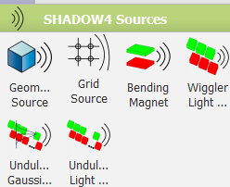
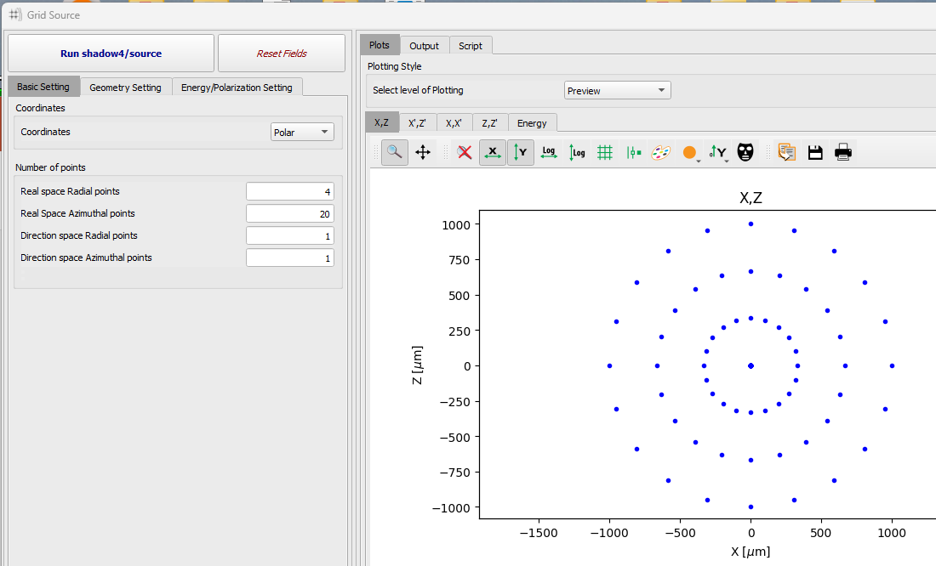
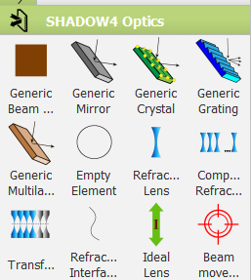
Shadow4 Kernel: beamline components
Sources/Magnetic structures
SourceGeometrical, SourceGridCartesian, SourceGridPolar)
S4BendingMagnet (upgraded methods¹)
S4Wiggler (included short IDs)
S4GaussianUndulator, S4Undulator (upgraded: see talk 1/2 of Juan Reyes-Herrera Today 18:15)
Optical elements
S4Screen (screens, slits, stops, absorbers)
S4IdealLens, S4Empty,… (ideal elements)
S4PlaneMirror, S4SphereMirror, S4EllipsoidalMirror, …, S4AdditionalNumericalMeshMirror
S4PlaneGrating, … (including VLS)
S4PlaneCrystal, … (undistorted perfect crystals in reflection)
S4PlaneMultilayer, … (also graded, in depth or laterally)
S4Interface, S4Lens, S4CRL, S4Transfocator (refractors)
[1] https://arxiv.org/abs/2406.16446

Slide 9
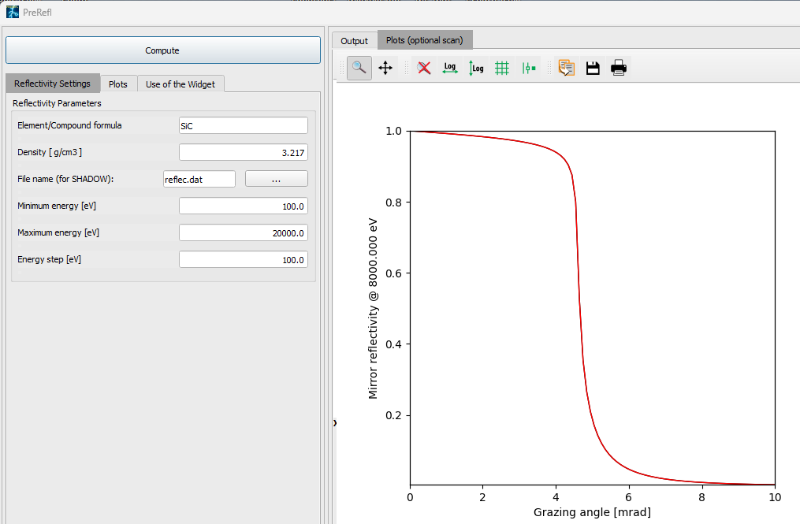
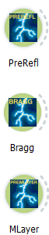
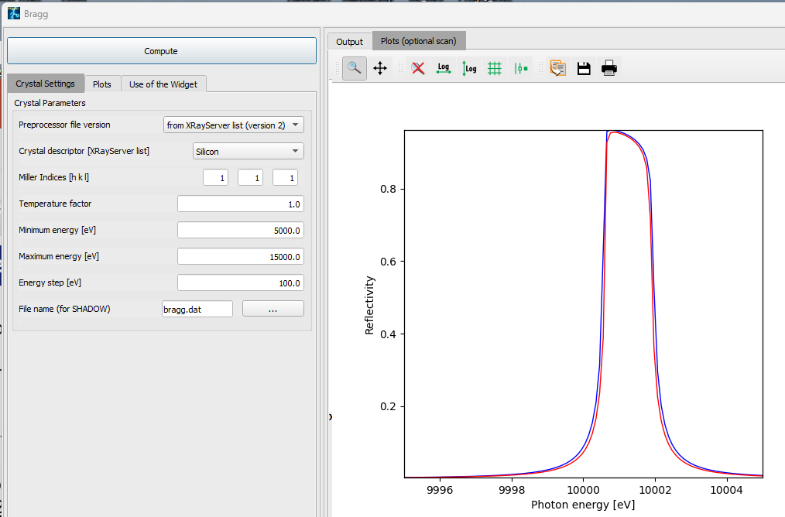
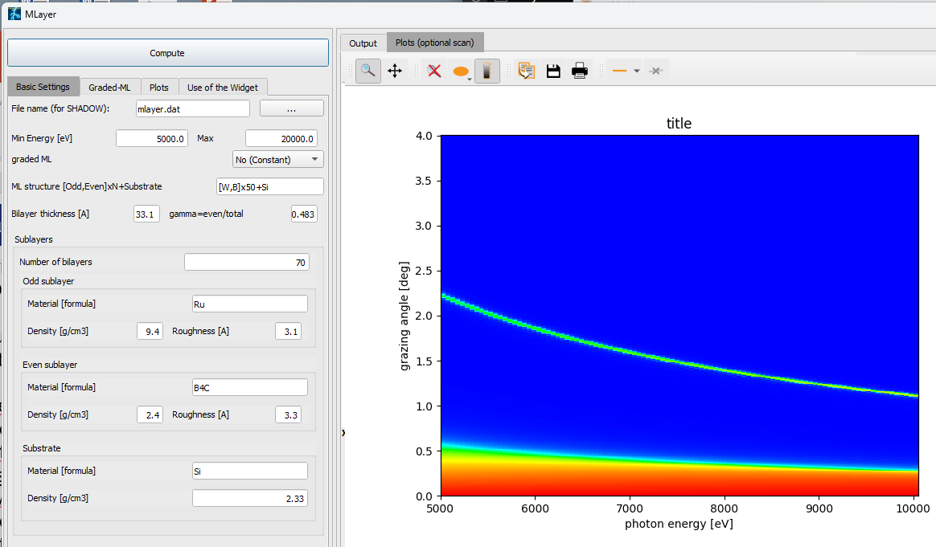
Shadow4 Kernel: models and algorithms
Geometrical model
S4OpticalSurface (S4Conic¹, S4Toroid, S4Mesh)
Include methods for reflection, refraction, grating scattering
Physical model (reflectivities)
preprocessors
code
PreRefl: Absorption/refraction for attenuators, mirrors, lenses
crystalpy²: external library for Crystals
MLayer
Optical constants (scattering factors, refraction indices, crystal structures)
preprocesor data file
direct link
xraylib³
DABAX⁴
[1] https://arxiv.org/abs/2406.04079
[2] https://arxiv.org/abs/2406.16960 https://github.com/oasys-kit/crystalpy
[3] https://github.com/tschoonj/xraylib
[4] https://github.com/oasys-kit/dabax

Slide 10
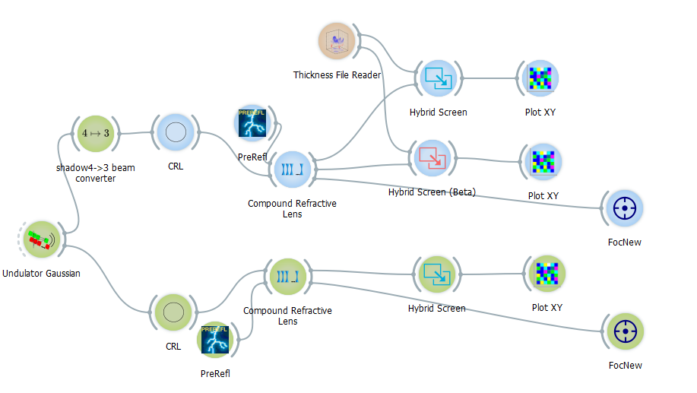
Shadow4: advanced tools – Hybrid¹ method
Corrects ray tracing considering scattering and diffraction when the beam has a high coherence
Includes scattering by o.e.’s boundaries (slits, mirrors, gratings, lenses)
Manages the surface error (delegated from o.e.)
Fully rewritten code²
Scriptable
[1] Shi et al. 2014 https://doi.org/10.1107/S160057751400650X
[2] https://github.com/oasys-kit/shadow4-advanced

Slide 11
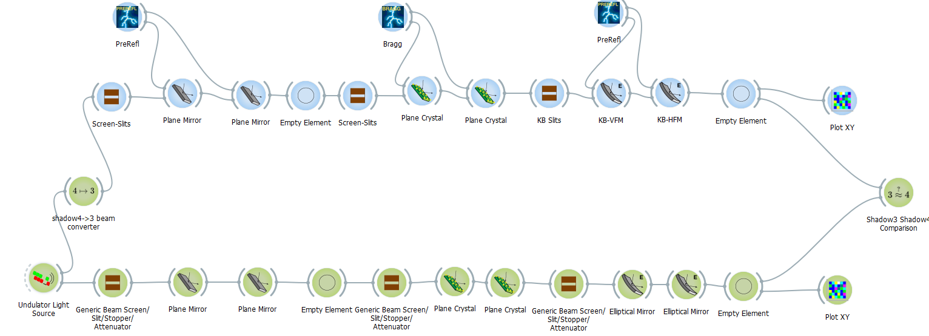
Shadow4: beta testers are welcomed!
Shadow3
beam converter
matching results
Shadow4
Send issues in https://github.com/oasys-kit/shadow4/issues

Slide 12
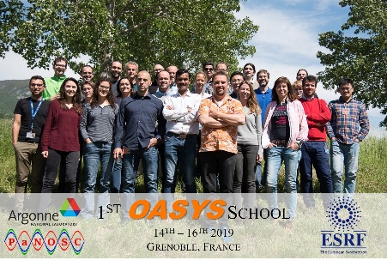
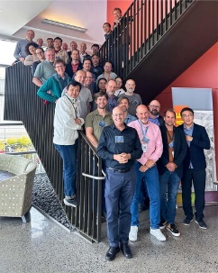
Shadow4: summary
SHADOW4 is announced
New Kernel fully in python, modern OO programming
New interface in OASYS, including Hybrid
Preparing the future SR generations
Already available in OASYS [beta]
Didactical material^{1,2} available.
Future OASYS schools (done at ESRF^{3,4}, APS³, ALS⁵)
[1] https://github.com/oasys-esrf-kit/oasys_hercules_2024
[2] https://github.com/oasys-kit/shadow4workspaces
[3] https://github.com/oasys-kit/oasys_school
[4] https://doi.org/10.1080/08940886.2019.1654832
[5] https://doi.org/10.1080/08940886.2023.2274746

Slide 13

Thank you
Download slides:

Slide 14

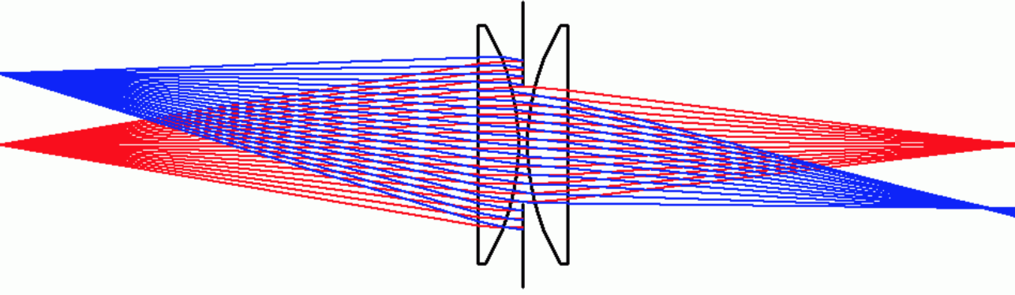
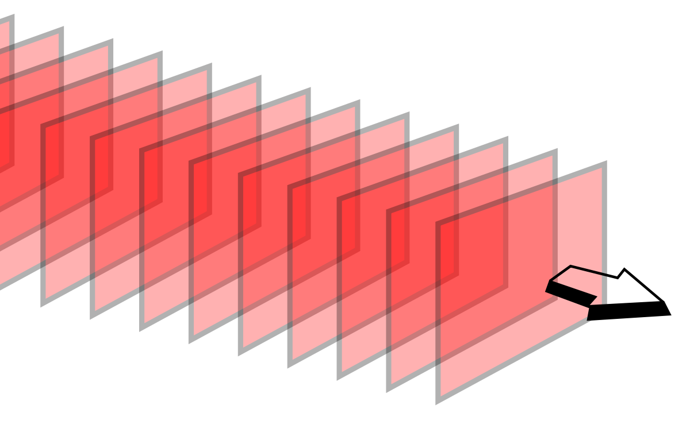
HIerarchical¹ BEAMLINE simulations with Oasys
Analytical model (by hand)
Ray tracing (Shadow4)
Hybrid model (Shadow4)
wave optics & partial coherence 1D (WOFRY) (see poster 1.141)
wave optics partial coherence 2D:
Monte Carlo (multi e⁻) (SRW)
Coherent Mode Decomposition (COMSYL)
COMPLEXITY
[1] M. Sanchez del Rio et al. 2019 https://doi.org/10.1107/S160057751901213X
Page 14

